Slide 1

G2M Case Study
Virtual Internship
Presented by: Roshan Gurung
12-Apr-2024

Slide 2
Background –G2M(cab industry) case study
XYZ is a private firm in US. Due to remarkable growth in the Cab Industry in last few years and multiple key players in the market, it is planning for an investment in Cab industry and as per their Go-to-Market(G2M) strategy they want to understand the market before taking final decision.
Objective : To Provide actionable insights to help XYZ firm in identifying the right company for making investment.
The analysis has been divided into four parts:
Data Description
Exploratory Data Analysis (EDA)
Recommendation for investment

Slide 3
Data Description
14 Features in the data which is formed by
combining multiple dataset.
Contains 3,59,392 data
About features:
Transaction ID: Unique transaction id
Date of travel : Date when the passenger travelled
Company: List of the companies
City : City where they travelled
KM travelled: Distance of the travelled per trip
Price charged: Price charged after a trip
Cost of trip: Original cost of the trip
Customer ID : Unique Id of the customer
Payment Method
Gender
Age
Income(USE/month)
Population
Users
Cab_Data.csv
Customer_ID.csv
Transaction_ID.csv
City.csv
Final cab data

Slide 4
Profit Analysis
Hypotheses
1. Company performance
- If one company has high number of cab users compare to the other one then the company has a higher average transaction amount as compared to other company
2. Customer Segmentation
- Customer with the age of 20-30 range uses cab a lot as compare to other age group as most of the youngster doesn’t have their own transport
- Customer with higher income tends to spend more on cab service
3. Profit and Margins
- The cost of trip increase with an increase in the number of customer
- Customer who tends to pay via card tend to spend more as compared to the customer who pay Via others mode.
4. Geographical trend
- -Cities with higher population have higher number of cab users.
5. Effect of external factor
- Cab usages decrease during the major holidays
6. customer loyalty
- customer who frequently uses cab services are more likely to be loyal to a particular company

Slide 5
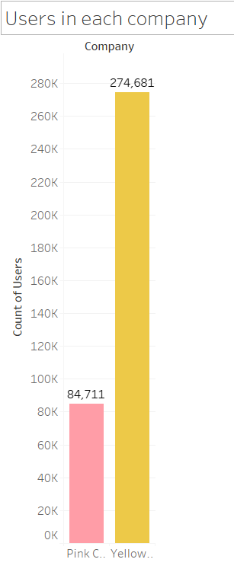
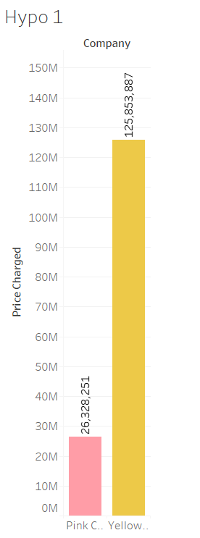
Profit Analysis
Exploratory Data Analysis
Hypothese 1. Company performance
- If one company has high number of cab users compare to the other one then the company has a higher average transaction amount as compared to other company

Slide 6
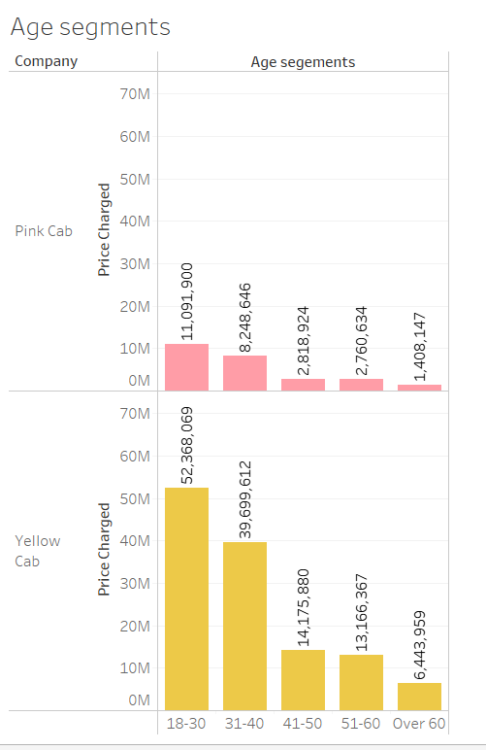
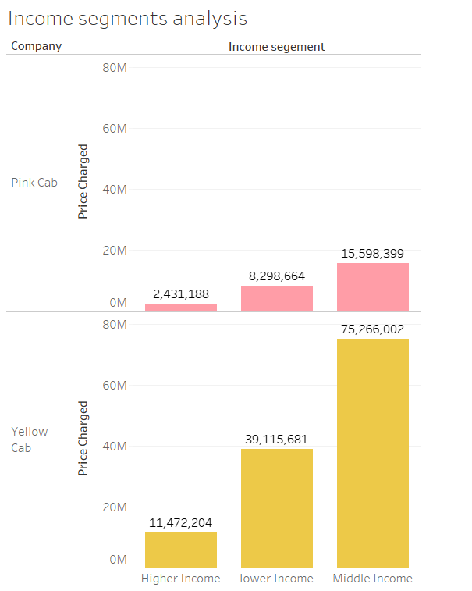
Profit Analysis
Exploratory Data Analysis
Hypothese 2. Customer Segmentation
2.1 Customer with the age of 20-30 range uses cab a lot as compare to other age group as most of the youngster doesn’t have their own transport
2.2 Customer with higher income tends to spend more on cab service
Result:
2.1 True as shown in the data customer with age 18-30 tends to spend more as compare to others
2.2 False: As people with higher income tends to spends less.

Slide 7
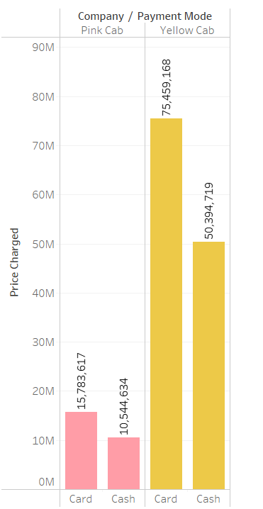
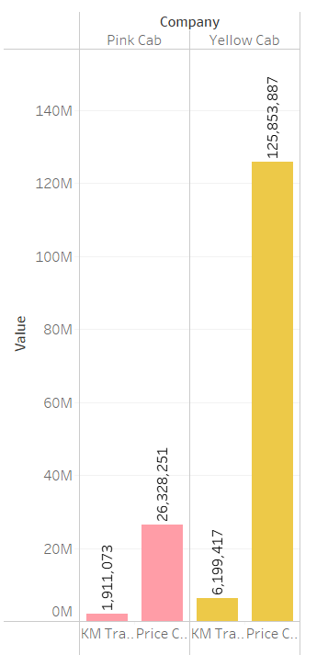
Profit Analysis
Exploratory Data Analysis
Hypothese 3. Profit and Margins
3.1Customer who tends to pay via card tend to spend more as compared to the customer who pay Via others
3.2 More travel means more income
Result:
3.1 It’s true that customer who pay by card has spend more money
3.2 True as shown in the chart more travel more price charged.

Slide 8
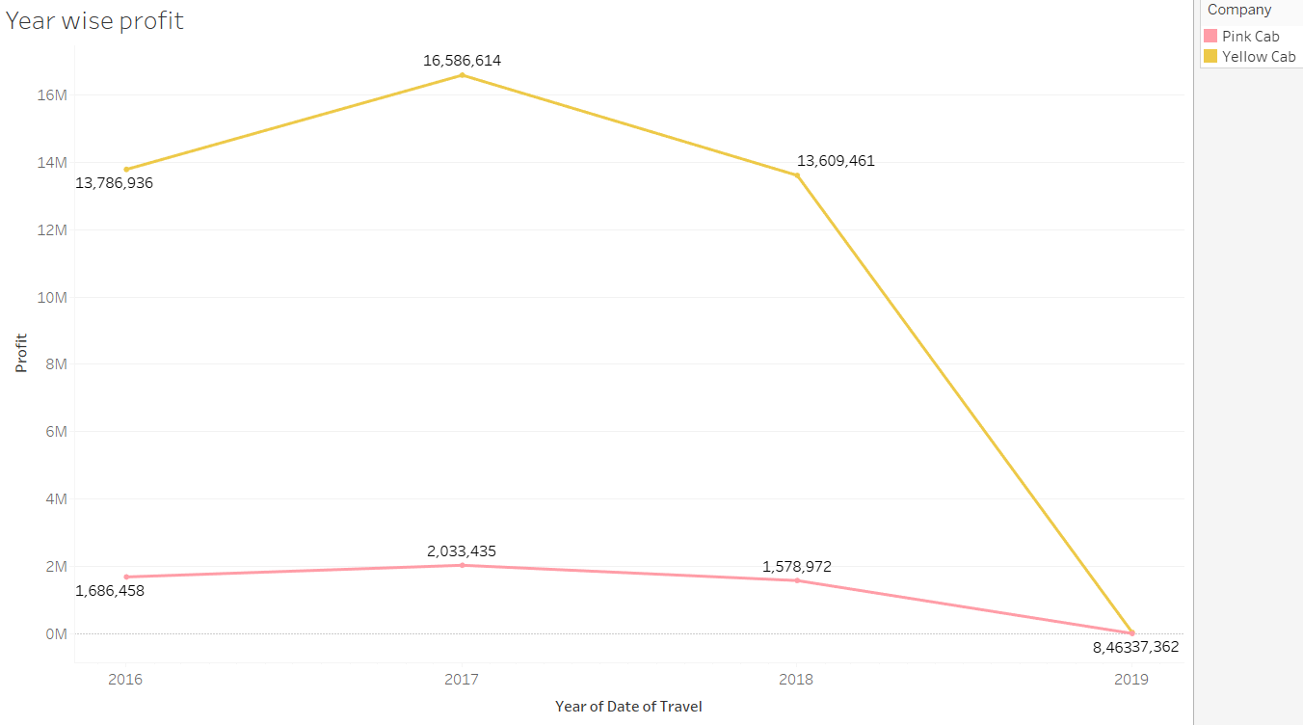
Yearly Profit Analysis

Slide 9
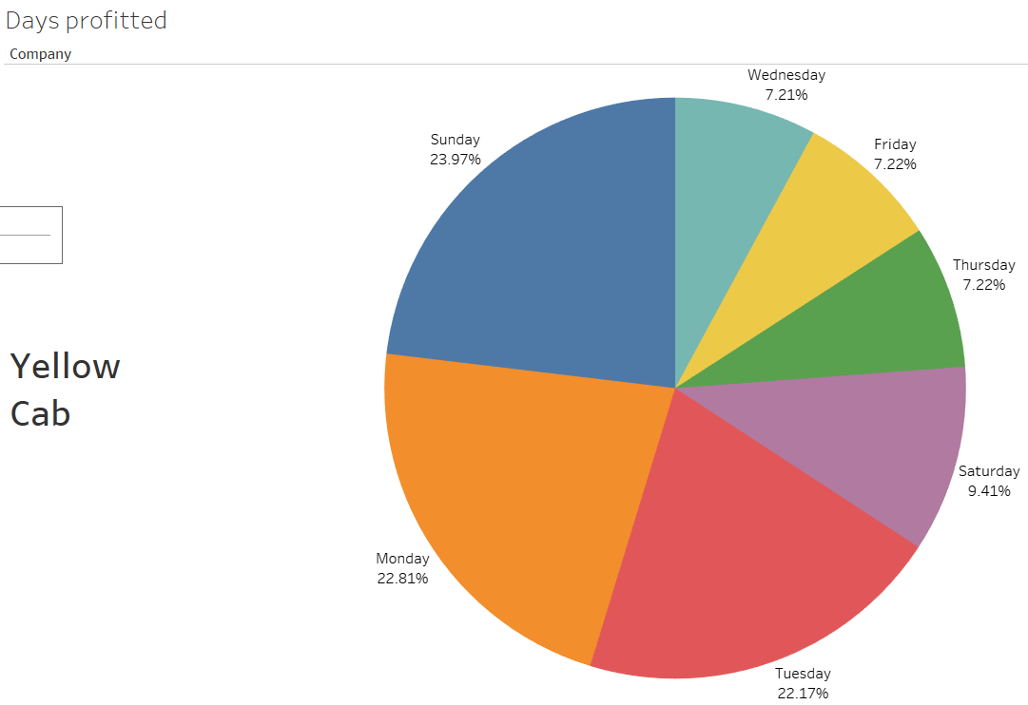
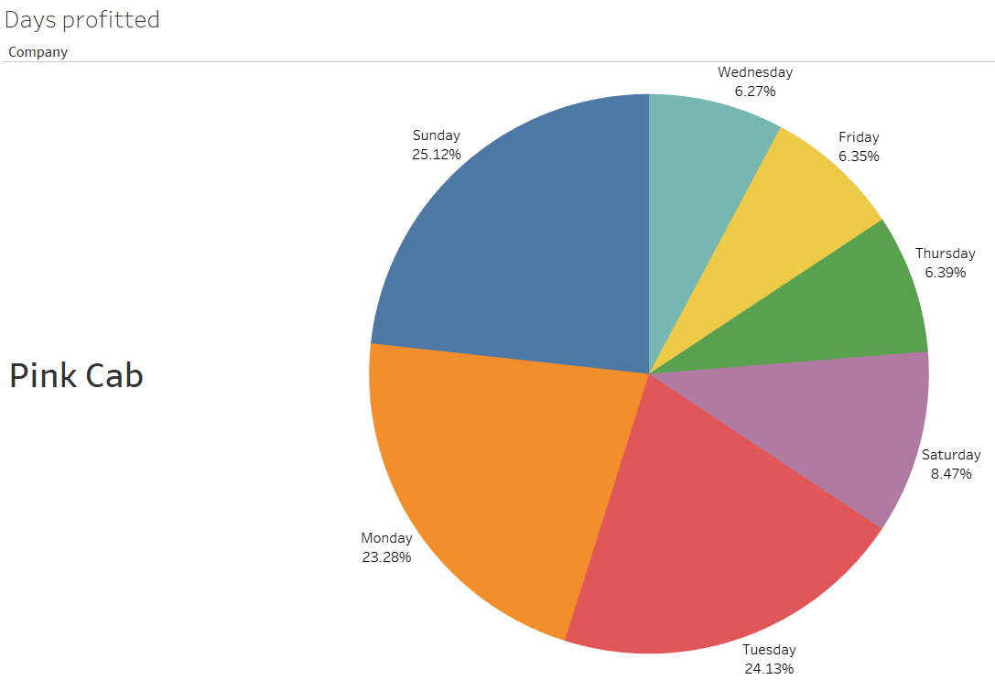
Days of the week Profit Analysis

Slide 10
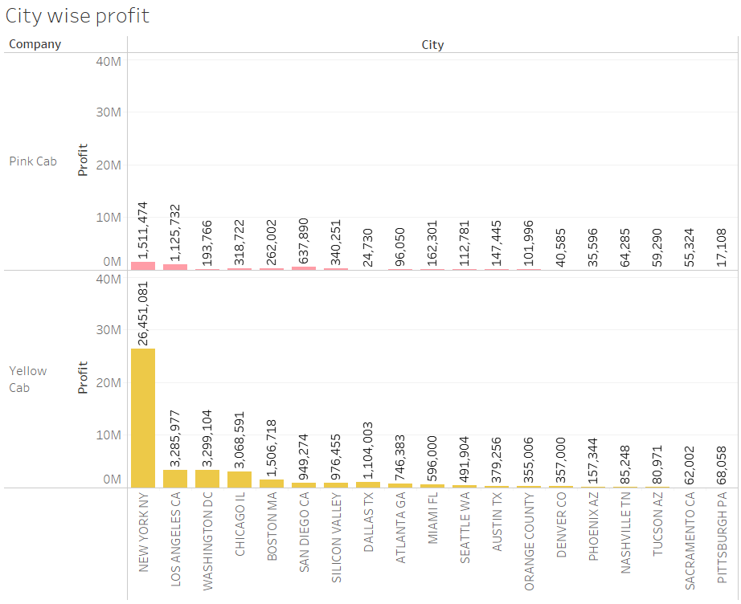
City wise profit analysis
Most profit are made in new York city where Yellow cab has done more profit as compare to pink cab

Slide 11
Recommendations
As shown by analysis Yellow cab is far better option then Pink cab so my recommendation is Yellow cab. The reasons are:
Profitable: Yellow cab is gaining more profit than pink cab every year.
Reach to more customer: As Yellow cab has more customer it can be more profitable and easier to advertise new product and services.

Slide 12
Thank You

